Slide 1

VARIABLES IN JAVASCRIPT
M. Fahraz Firdaus
Malik Pajar Anugrah
Adinda Clara
M. Fikry Haikal

Slide 2
The use of `var`, `let`, and `const` in JavaScript is to define variables. However, there are important differences in how they behave:

Slide 3
-1-
VAR

Slide 4
Variables declared with `var` have a scope function, not a block. This means the variable `var` can be accessed across functions where it is declared. It also has hoisting, which means its variable declaration will be hoisted to the top of the function or block, but its initial value will remain `unfine` until the variable is initialized.

Slide 5
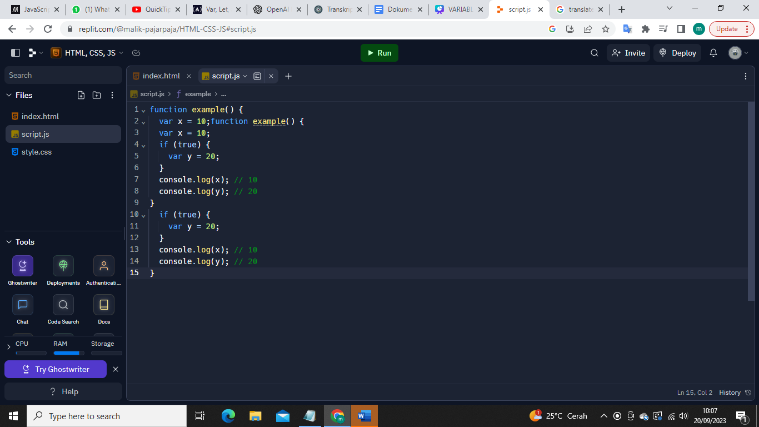
Example :

Slide 6
-2-
LET

Slide 7
Variables declared with `let` are block scoped. This means the `let` variable can only be accessed within the block where it is declared. `let` has no hoisting, so you must initialize the variable before using it.

Slide 8
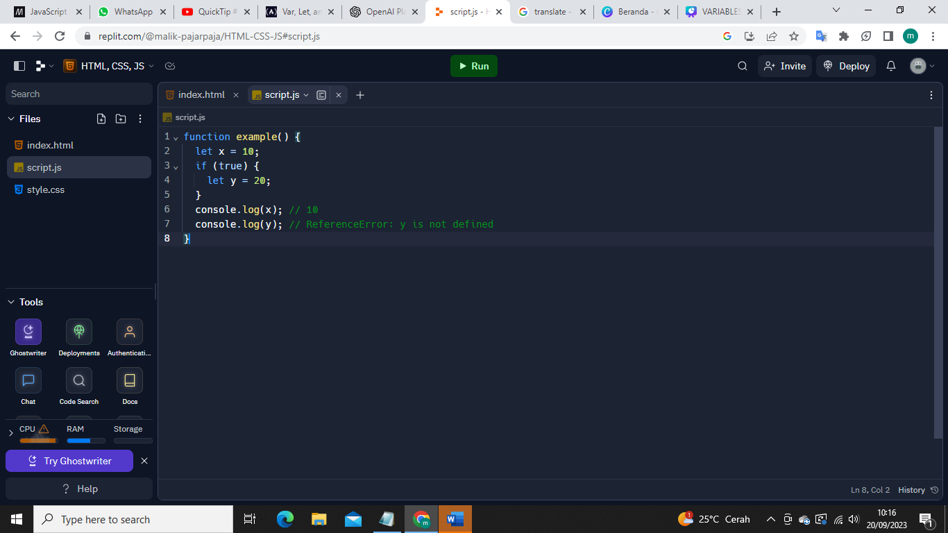
Example :

Slide 9
-3-
CONST

Slide 10
Variables declared with `const` also have block scope like `let`, but they must be initialized when declared, and the gain cannot be changed afterwards. This is suitable for variables whose values ​​cannot change.

Slide 11
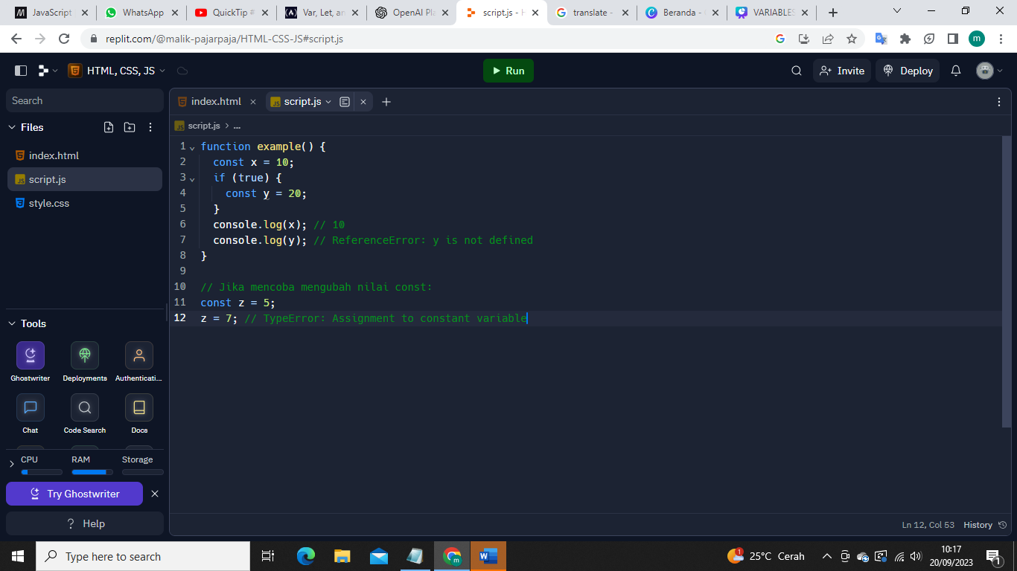
Example :

Slide 12
So, in modern JavaScript programming, it is recommended to use `let` and `const` instead of `var` unless there is a specific reason to use `var`.

